Slide 1
Letters of Recommendation
Accepting, Writing, & Uploading to Naviance

Slide 2
How should a student ask?
In person
Offer you a copy of a brag sheet & summary of activities
Return these documents, give you a deadline (this deadline should be 2 weeks before the college deadline)

Slide 3
What should your letter say?
Use the brag sheet!
Discuss behavior in the classroom - how are they as a student? Do they participate readily? Do they lead the discussion? Are they more of the quiet thinker?
Avoid topics that are better covered in the counselor letter (i.e. personal situations of the student, personal characteristics that don’t relate to academics)

Slide 4
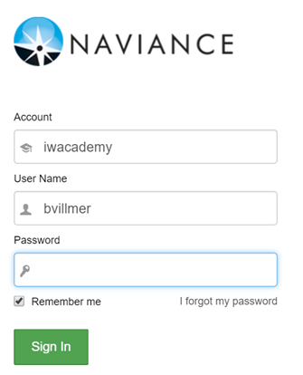
Logging into Naviance
https://succeed.naviance.com/auth/signin

Slide 5
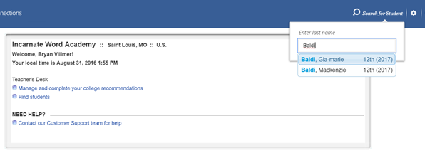
Uploading to Naviance

Slide 6
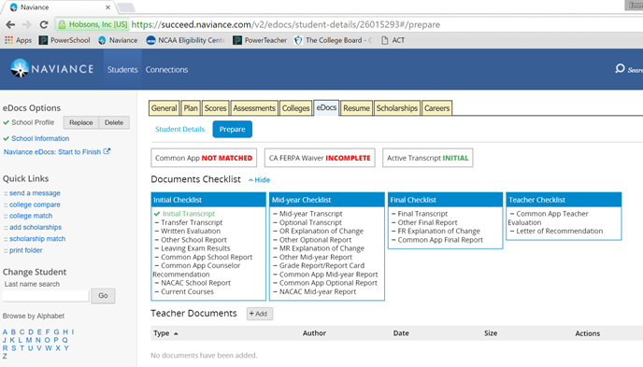
Uploading to Naviance

Slide 7
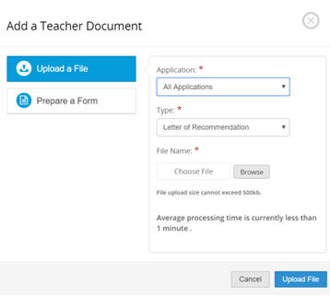
Uploading to Naviance

Slide 8
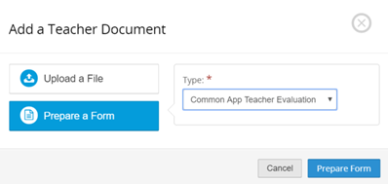
Uploading to Naviance

